Slide 1
RShiny (Visualization with R)
簡廷因 Ting-Ying Chien
2022.03.31

Slide 2
Shiny
A web application framework for R
Interactive web applications
No HTML, CSS, or JavaScript knowledge required
E.g
http://shiny.rstudio.com/gallery/bus-dashboard.html
http://shiny.rstudio.com/gallery/google-charts.html
http://shiny.rstudio.com/gallery/datatables-options.html

Slide 3
Install Shiny server
Centos
Ubuntu
sudo yum install R
sudo su - -c "R -e \"install.packages('shiny', repos='http://cran.rstudio.com/')\""
wget https://download3.rstudio.org/centos7/x86_64/shiny-server-1.5.17.973-x86_64.rpm
sudo yum install --nogpgcheck shiny-server-1.5.17.973-x86_64.rpm
sudo apt-get install r-base
sudo su - -c "R -e \"install.packages('shiny', repos='http://cran.rstudio.com/')\""
sudo apt-get install gdebi-core
wget https://download3.rstudio.org/ubuntu-14.04/x86_64/shiny-server-1.5.17.973-amd64.deb
sudo gdebi shiny-server-1.5.17.973-amd64.deb

Slide 4

server
Step 1: login to 140.138.77.70
Step2 : create directory
mkdir /srv/shiny-server/YOURID/
# e.g mkdir /srv/shiny-server/s1001234/

Slide 5
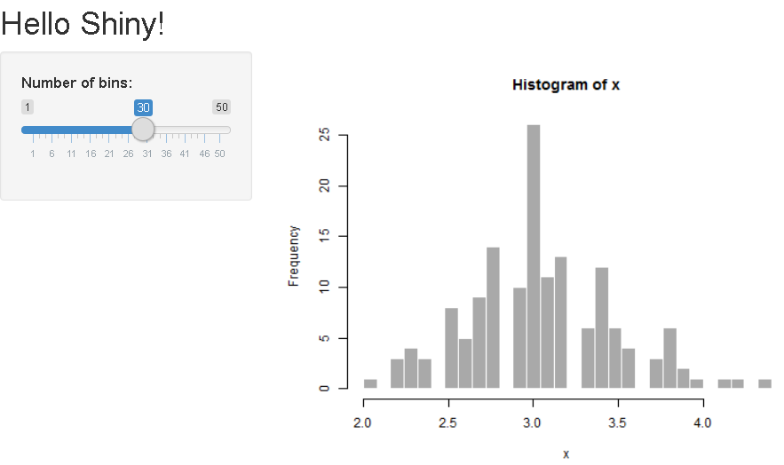
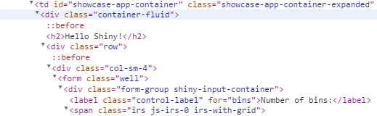
First app
titlePanel
ui.R (front-end)
sidebarPanel
> library(shiny)
# Define UI for application that draws a histogram
> shinyUI(fluidPage(
# Application title
> titlePanel("Hello Shiny!"), # page title
# Sidebar with a slider input for the number of bins
> sidebarLayout(
> sidebarPanel(
> sliderInput("bins", # input ID
> "Number of bins:", #label
> min = 1,
> max = 50,
> value = 30) #default value
> ),
# Show a plot of the generated distribution
> mainPanel(
> plotOutput("distPlot") #output ID
> )
> )
>))
mainPanel

Slide 6
First app
server.R (back-end)
> library(shiny)
# Define server logic required to draw a histogram
> shinyServer(function(input, output) {
# Expression that generates a histogram. The expression is
# wrapped in a call to renderPlot to indicate that:
#
# 1) It is "reactive" and therefore should be automatically
# re-executed when inputs change
# 2) Its output type is a plot
> output$distPlot <- renderPlot({
> x = iris[, 2] # Iris dataset (Sepal.Width)
> bins = seq(min(x), max(x), length.out = input$bins + 1)
# draw the histogram with the specified number of bins
> hist(x, breaks = bins, col = 'darkgray', border = 'white')
> })
> })

Slide 7
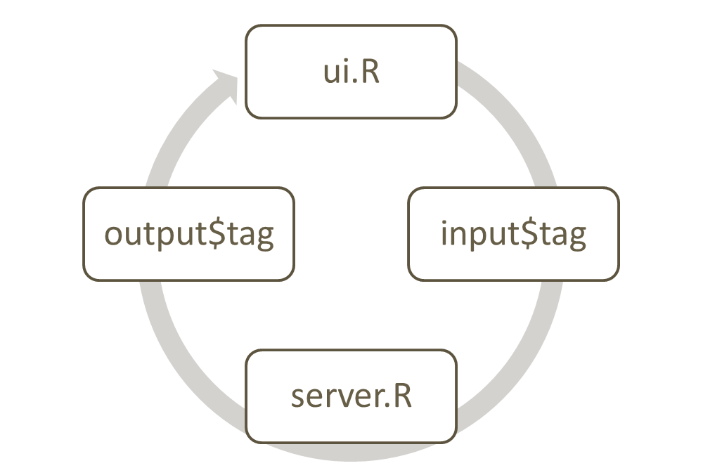
First app
Step 1: user select
ui.R
> library(shiny)
> shinyUI(fluidPage(
> titlePanel("Hello Shiny!"),
> sidebarLayout(
> sidebarPanel(
> sliderInput("bins",
> "Number of bins:",
> min = 1,
> max = 50,
> value = 30)
> ),
> mainPanel(
> plotOutput("distPlot")
> )
> )
>))
Step 2: Input tag to server.R
Ref:http://programmermagazine.github.io/201309/book/pmag.html
server.R
> library(shiny)
> shinyServer(function(input, output) {
> output$distPlot <- renderPlot({
> x = iris[, 2] # Iris dataset (Sepal.Width)
> bins = seq(min(x), max(x), length.out = input$bins + 1)
> hist(x, breaks = bins, col = 'darkgray', border = 'white')
> })
> })
Step 3: Output tag to ui.R

Slide 8
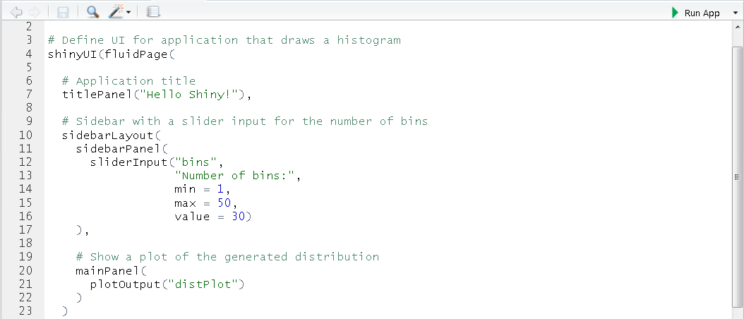
First app
Run app (Windows)
Save server.R and ui.R in the same directory
Run app in Rstudio

Slide 9
First app
Run app (server)
Add directory
save server.r and ui.r in /srv/shiny-server/YOURID/APPID
url: http://140.138.77.70:3838/YOURID/APPID/
mkdir /srv/shiny-server/YOURID/APPID

Slide 10
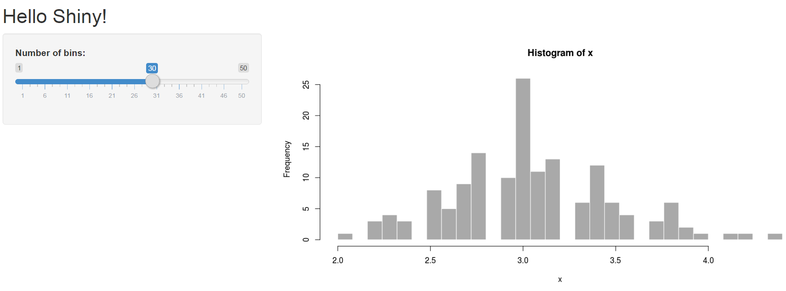
Exercise
Run first app in the server

Slide 11
File Name
Server.r
Server logic definition
UI.r
User interface definition
Global.r
loading and defining variables for the global environment

Slide 12
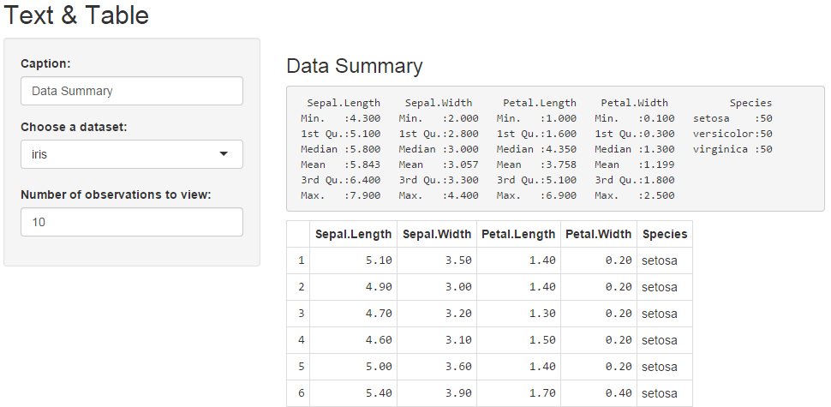
Text & Table
ui.R
> library(shiny)
# Define UI for dataset viewer application
> shinyUI(fluidPage(
# Application title
> titlePanel("Text & Table"),
# Sidebar with controls to provide a caption, select a dataset,
# and specify the number of observations to view. Note that
# changes made to the caption in the textInput control are
# updated in the output area immediately as you type
> sidebarLayout(
> sidebarPanel(
> textInput("caption", "Caption:", "Data Summary"),
> selectInput("dataset", "Choose a dataset:",
+ choices = c("iris", "mtcars", "USArrests")),
> numericInput("obs", "Number of observations to view:", 10)
> ),
# Show the caption, a summary of the dataset and an HTML
# table with the requested number of observations
> mainPanel(
> h3(textOutput("caption", container = span)),
> verbatimTextOutput("summary"),
> tableOutput("view")
> )
> )
>))

Slide 13
Text & Table
server.R
> library(shiny)
> library(datasets)
# Define server logic required to summarize and view the selected
# dataset
> shinyServer(function(input, output) {
# Return the requested dataset
> datasetInput <- reactive({
> switch(input$dataset,
> "iris" = iris,
> "mtcars" = mtcars,
> "USArrests" = USArrests)
> })
> output$caption <- renderText({
> input$caption
> })
# Generate a summary of the dataset
> output$summary <- renderPrint({
> dataset = datasetInput()
> summary(dataset)
> })
# Show the first "n" observations
> output$view <- renderTable({
> head(datasetInput(), n = input$obs)
> })
>})
The output$caption is computed based on a reactive expression that returns input$caption. When the user changes the "caption" field:
1) This function is automatically called to recompute the output
2) The new caption is pushed back to the browser for re-display
The output$summary depends on the datasetInput reactive expression, so will be re-executed whenever datasetInput is invalidated (i.e. whenever the input$dataset changes)

Slide 14
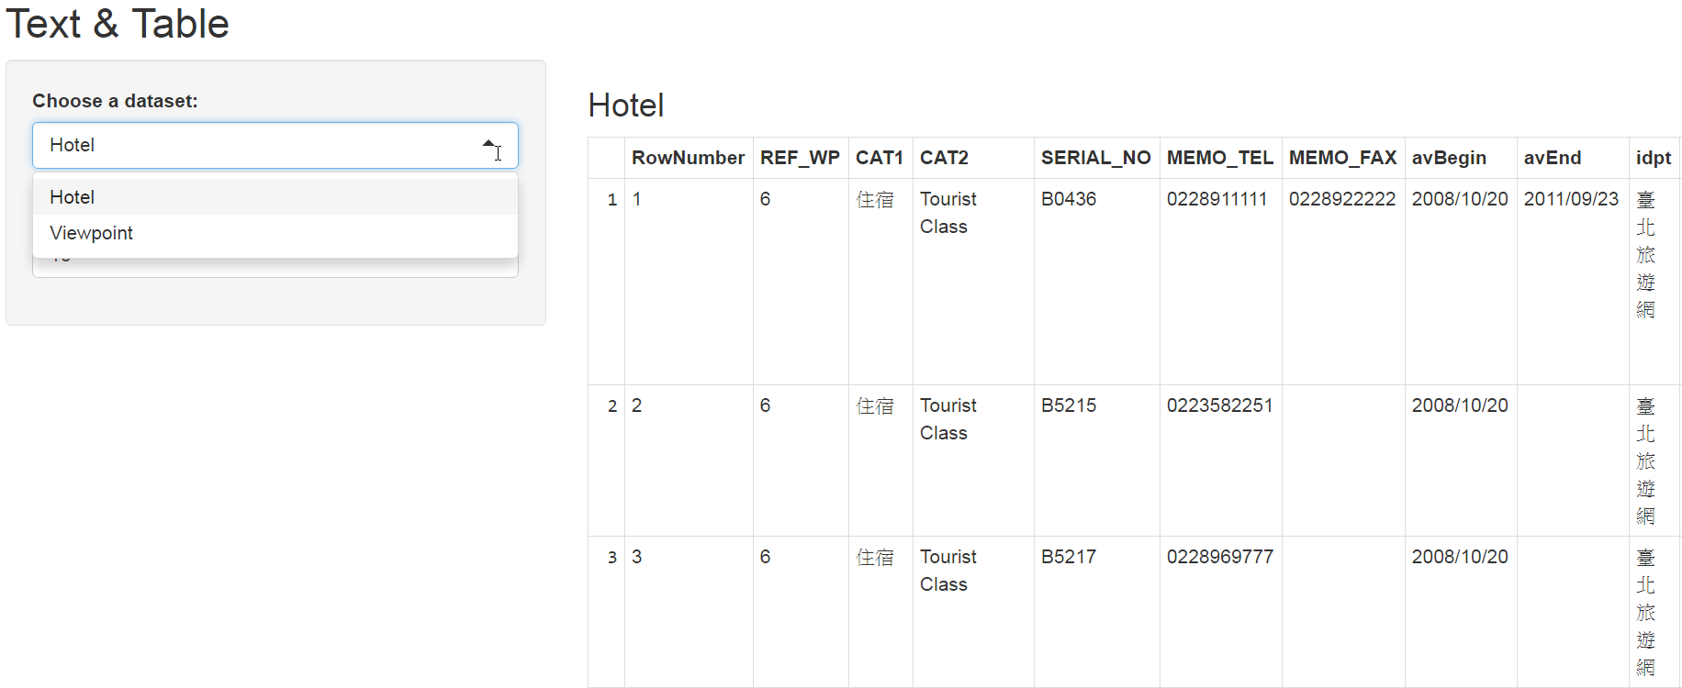
Exercise
Dataset:
hotel.xml
viewpoint.xml
Report the table by user selected
Hotel
Viewpoint

Slide 15
Exercise
Dataset
Taoyuan_LAND_A.csv
the actual price registration in Taoyuan
Report a summary and histogram of district by user selected
Fuxing, Taoyuan, Yangmei, Daxi, Longtan, Guanyin, Dayuan, Xinwu, Zhongli, Pingzhen, Guishan, Bade, Luzhu

Slide 16
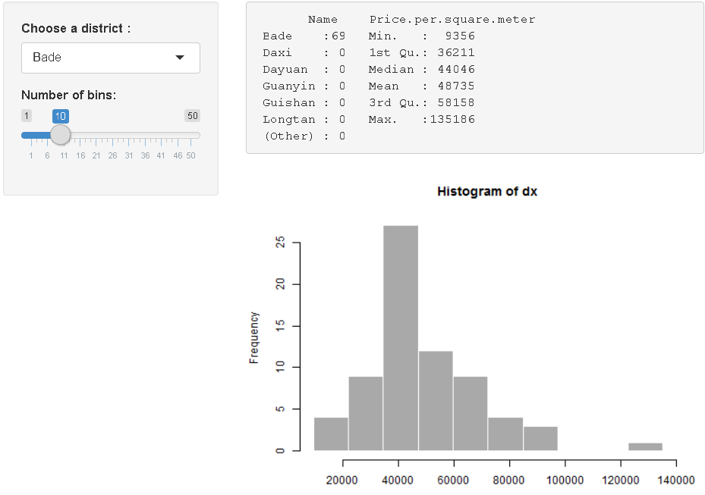
Exercise

Slide 17
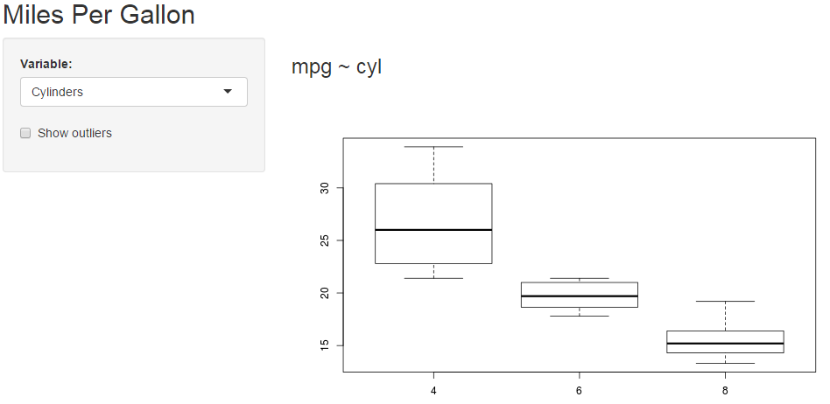
Boxplot
ui.R
> library(shiny)
# Define UI for miles per gallon application
> shinyUI(fluidPage(
# Application title
> titlePanel("Miles Per Gallon"),
# Sidebar with controls to select the variable to plot against
# mpg and to specify whether outliers should be included
> sidebarLayout(
> sidebarPanel(
> selectInput("variable", "Variable:",
> c("Cylinders" = "cyl",
> "Transmission" = "am",
> "Gears" = "gear")),
> checkboxInput("outliers", "Show outliers", FALSE)
> ),
# Show the caption and plot of the requested variable against mpg
> mainPanel(
> h3(textOutput("caption")),
> plotOutput("mpgPlot")
> )
> )
> ))

Slide 18
Boxplot
server.R
> library(shiny)
> mpgData = mtcars
> mpgData$am = factor(mpgData$am, labels = c("Automatic", "Manual"))
# Define server logic required to plot various variables against mpg
> shinyServer(function(input, output) {
# Compute the formula text in a reactive expression since it is
# shared by the output$caption and output$mpgPlot functions
> formulaText <- reactive({
> paste("mpg ~", input$variable)
> })
# Return the formula text for printing as a caption
> output$caption <- renderText({
> formulaText()
})
# Generate a plot of the requested variable against mpg and
# only include outliers if requested
> output$mpgPlot <- renderPlot({
> boxplot(as.formula(formulaText()),
> data = mpgData,
> outline = input$outliers)
> })
>})

Slide 19
Exercise
Dataset
2014Chungli.csv
The air quality in ChungLi in 2014
Show the average of PM2.5 and PM10 every day in ChungLi in 2014
> library(ggplot2)
> ggplot(pm25, aes(Date, PM2.5, group=Station, colour=Station))
+ + geom_line()
+ + labs(x="Date", y="PM2.5", title="2014 ChungLi PM2.5")
+ + theme(legend.position = "none")

Slide 20
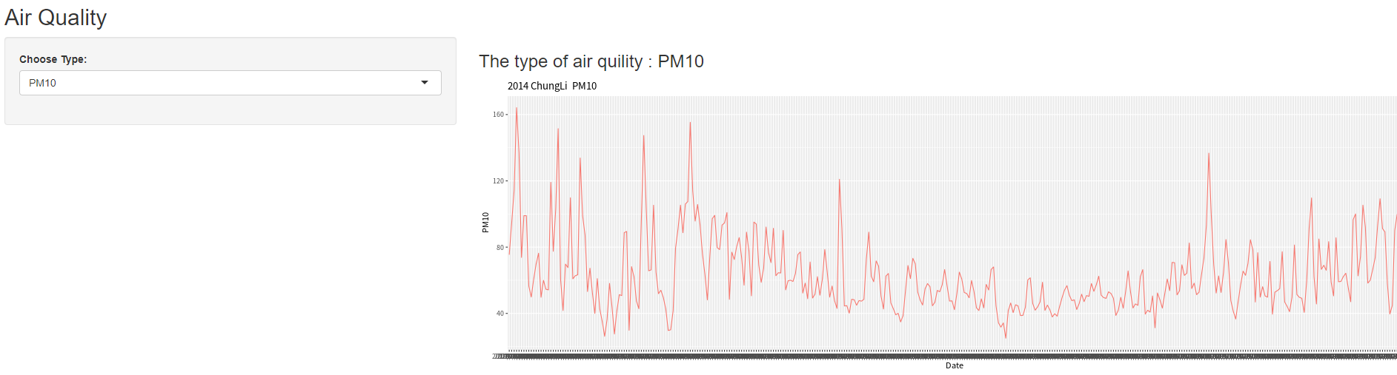
Exercise

Slide 21
Exercise
Dataset:
Weather.csv
LocationName :
Taipei, New Taipei, Taoyuan, Taichung, Tainan, Kaohsiung
User selected :
LocationName, Type: (Max Temp. or Min Temp.)
Use table and line chart to display the weather information
ggplot2

Slide 22
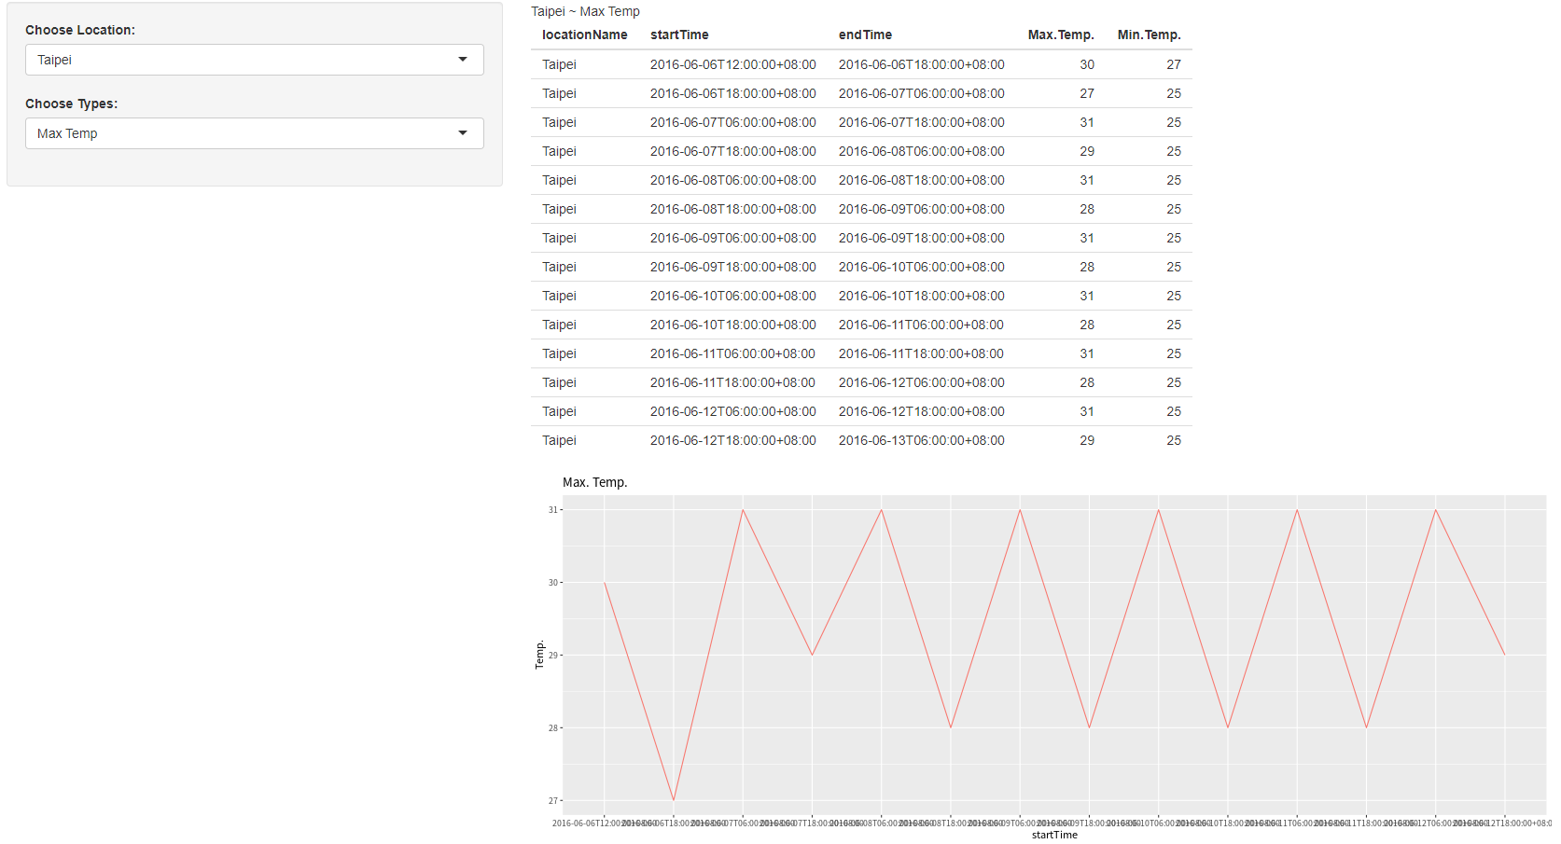
Exercise

Slide 23
Exercise
Show the real time air quality in the map
https://data.epa.gov.tw/api/v1/aqx_p_432?api_key=9be7b239-557b-4c10-9775-78cadfc555e9&format=csv
Ref Rplot.v2 p75
Note : User can select air pollutant
Hint : plotOutput -> leafletOutput

Slide 24
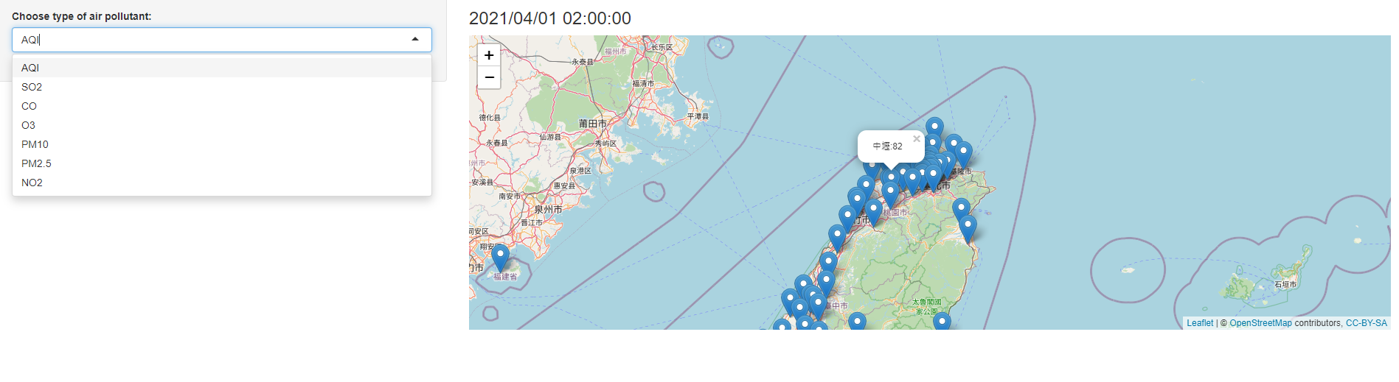
Exercise

Slide 25
Exercise
Others dataset
NYC data
https://nycopendata.socrata.com/
Taipei open data
http://data.taipei/opendata/
Taiwan open data
http://data.gov.tw/
Application
Statistic / Summary
Plot
Map

Slide 26
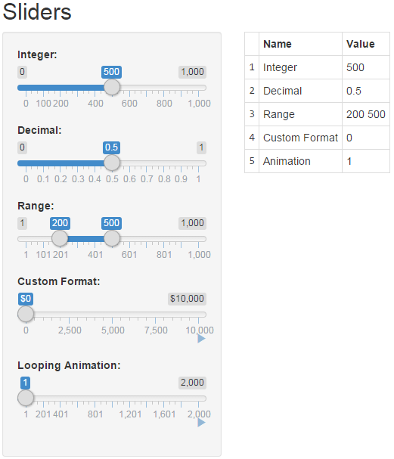
sliders
ui.R
> library(shiny)
# Define UI for slider demo application
> shinyUI(fluidPage(
# Application title
> titlePanel("Sliders"),
# Sidebar with sliders that demonstrate various available options
> sidebarLayout(
> sidebarPanel(
# Simple integer interval
> sliderInput("integer", "Integer:", min=0, max=1000, value=500),
# Decimal interval with step value
> sliderInput("decimal", "Decimal:", min = 0, max = 1, value = 0.5, step= 0.1),
# Specification of range within an interval
> sliderInput("range", "Range:", min = 1, max = 1000, value = c(200,500)),
# Provide a custom currency format for value display, with basic animation
> sliderInput("format", "Custom Format:", min = 0, max = 10000, value = 0, step = 2500,
+ pre = "$", sep = ",", animate=TRUE),
# Animation with custom interval (in ms) to control speed, plus looping
> sliderInput("animation", "Looping Animation:", 1, 2000, 1,
+ step = 10, animate= animationOptions(interval=300, loop=TRUE))
> ),
# Show a table summarizing the values entered
> mainPanel( tableOutput("values") )
> )
>))

Slide 27
sliders
server.R
> library(shiny)
# Define server logic for slider examples
> shinyServer(function(input, output) {
# Reactive expression to compose a data frame containing all of
# the values
> sliderValues <- reactive({
# Compose data frame
> data.frame(
> Name = c("Integer",
> "Decimal",
> "Range",
> "Custom Format",
> "Animation"),
> Value = as.character(c(input$integer,
> input$decimal,
> paste(input$range, collapse=' '),
> input$format,
> input$animation)),
> stringsAsFactors=FALSE)
> })
# Show the values using an HTML table
> output$values <- renderTable({
> sliderValues()
> })
>})

Slide 28
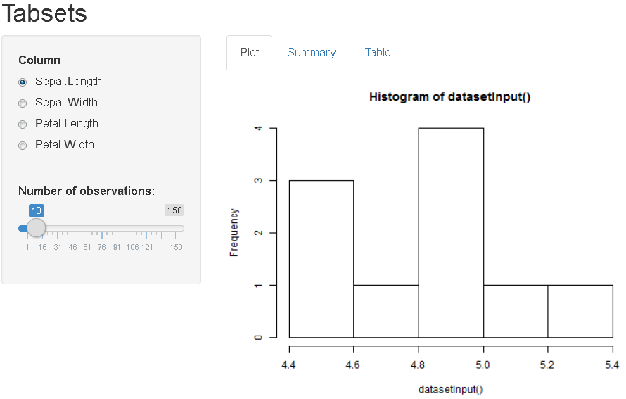
Tabset
ui.R
> library(shiny)
# Define UI for iris dataset
> shinyUI(fluidPage(
# Application title
> titlePanel("Tabsets"),
> sidebarLayout(
> sidebarPanel(
> radioButtons("dataset", "Column",
+ choices = c("Sepal.Length", "Sepal.Width", "Petal.Length", "Petal.Width")),
# The br() element to introduce extra vertical spacing
> br(),
> sliderInput("n", "Number of observations:", value = 10, min = 1, max = 150)
> ),
# Show a tabset that includes a plot, summary, and table view of the generated distribution
> mainPanel(
> tabsetPanel(type = "tabs",
> tabPanel("Plot", plotOutput("plot")),
> tabPanel("Summary", verbatimTextOutput("summary")),
> tabPanel("Table", tableOutput("table"))
> )
> )
> )
>))
label
ID

Slide 29
Tabset
server.R
> library(shiny)
# Define server logic required for iris dataset
> shinyServer(function(input, output) {
# Return the requested dataset
> datasetInput <- reactive({
> data=switch(input$dataset,
+ "Sepal.Length" = iris$Sepal.Length, "Sepal.Width" = iris$Sepal.Width,
+ "Petal.Length" = iris$Petal.Length, "Petal.Width" = iris$Petal.Width)
> data[1:input$n]
> })
> output$plot <- renderPlot({
> hist(datasetInput())
> })
# Generate a summary of the dataset
> output$summary <- renderPrint({
> summary(datasetInput())
})
# Show the first "n" observations
> output$table <- renderTable({
> dataset=datasetInput()
> data.frame(x=datasetInput())
> })
>})

Slide 30
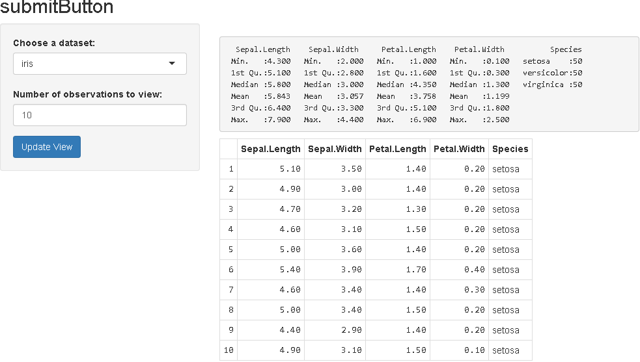
submitButton
ui.R
> library(shiny)
# Define UI for dataset viewer application
> shinyUI(fluidPage(
# Application title
> titlePanel("submitButton"),
# submitButton defers the rendering of output until the user explicitly clicks the button
#(rather than doing it immediately when inputs change)
> sidebarLayout(
> sidebarPanel(
> selectInput("dataset", "Choose a dataset:",
+ choices = c("iris", "mtcars", "USArrests")),
> numericInput("obs", "Number of observations to view:", 10),
> submitButton("Update View")
> ),
> mainPanel(
> verbatimTextOutput("summary"),
> tableOutput("view")
> )
> )
>))

Slide 31
submitButton
server.R
> library(shiny)
> library(datasets)
# Define server logic required to summarize and view the selected dataset
> shinyServer(function(input, output) {
# Return the requested dataset
> datasetInput <- reactive({
> switch(input$dataset,
> "iris" = iris,
> "mtcars" = mtcars,
> "USArrests" = USArrests)
> })
# Generate a summary of the dataset
> output$summary <- renderPrint({
> dataset = datasetInput()
> summary(dataset)
> })
# Show the first "n" observations
> output$view <- renderTable({
> head(datasetInput(), n = input$obs)
> })
>})

Slide 32
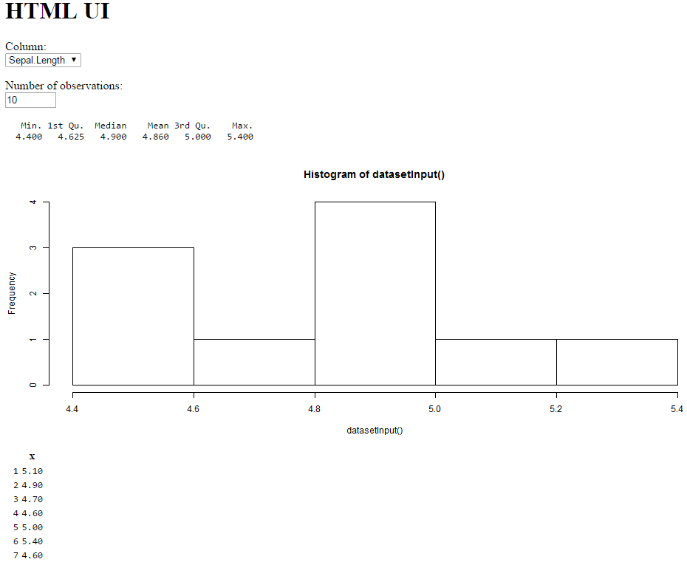
From HTML
www/index.html
<html>
<head>
<script src="shared/jquery.js" type="text/javascript"></script>
<script src="shared/shiny.js" type="text/javascript"></script>
<link rel="stylesheet" type="text/css" href="shared/shiny.css"/>
</head>
<body>
<h1>HTML UI</h1>
<p>
<label>Column:</label><br />
<select name="dataset">
<option value="Sepal.Length">Sepal.Length</option>
<option value="Sepal.Width">Sepal.Width</option>
<option value="Petal.Length">Petal.Length</option>
<option value="Petal.Width">Petal.Width</option>
</select>
</p>
<p>
<label>Number of observations:</label><br />
<input type="number" name="n" value="10" min="1" max="150" />
</p>
<pre id="summary" class="shiny-text-output"></pre>
<div id="plot" class="shiny-plot-output" style="width: 100%; height: 400px"></div>
<div id="table" class="shiny-html-output"></div>
</body>
</html>

Slide 33
From HTML
server.R
> library(shiny)
# Define server logic required for iris dataset
> shinyServer(function(input, output) {
# Return the requested dataset
> datasetInput <- reactive({
> data=switch(input$dataset,
+ "Sepal.Length" = iris$Sepal.Length, "Sepal.Width" = iris$Sepal.Width,
+ "Petal.Length" = iris$Petal.Length, "Petal.Width" = iris$Petal.Width)
> data[1:input$n]
> })
> output$plot <- renderPlot({
> hist(datasetInput())
> })
# Generate a summary of the dataset
> output$summary <- renderPrint({
> summary(datasetInput())
})
# Show the first "n" observations
> output$table <- renderTable({
> dataset=datasetInput()
> data.frame(x=datasetInput())
> })
>})

Slide 34
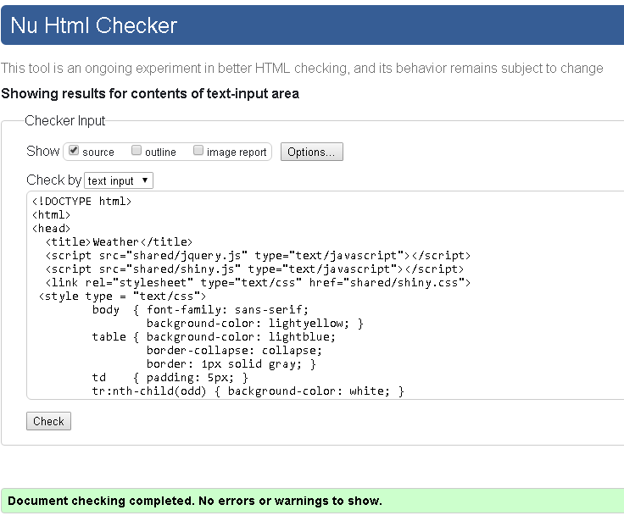
From HTML (include CSS)
www/index.html
Check your HTML code
Markup Validation Service https://validator.w3.org/
<!DOCTYPE html>
<html>
<head>
<title>Weather</title>
<script src="shared/jquery.js" type="text/javascript"></script>
<script src="shared/shiny.js" type="text/javascript"></script>
<link rel="stylesheet" type="text/css" href="shared/shiny.css">
<style type = "text/css">
body { font-family: sans-serif;
background-color: lightyellow; }
table { background-color: lightblue;
border-collapse: collapse;
border: 1px solid gray; }
td { padding: 5px; }
tr:nth-child(odd) { background-color: white; }
</style>
</head>

Slide 35
From HTML (include CSS)
www/index.html
<body>
<h1>Weather</h1>
<form action="#">
<p>
<label>Location:</label><br />
<select name="local">
<option value="Taipei"> Taipei</option>
<option value="New Taipei">New Taipei</option>
<option value="Taoyuan"> Taoyuan</option>
<option value="Taichung"> Taichung</option>
<option value="Tainan"> Tainan</option>
<option value="Kaohsing"> Kaohsing</option>
</select>
</p>
<p>
<label>Type:</label><br />
<select name="type">
<option value="Max"> Max Temp.</option>
<option value="Min"> Min Temp.</option>
</select>
</p>
<div id="view" class="shiny-html-output"></div>
<div id="mpgPlot" class="shiny-plot-output" style="width: 50%; height: 400px"></div>
</form>
</body>
</html>

Slide 36
From HTML (include CSS)
server.R
> library(shiny)
> library(dplyr)
> library(ggplot2)
> shinyServer(function(input, output) {
> datasetInput <- reactive({
> switch(input$type,
> "Max" = x[,1:4],
> "Min" = x[,c(1:3,5)])
> })
> output$view <- renderTable({
> dataset=datasetInput()
> dataset%>% filter(locationName==input$local)
> })
> output$mpgPlot <- renderPlot({
> dataset = datasetInput()
> data= dataset %>% filter(locationName==input$local)
> plot(data[,4],xlab="Time",ylab="Temperature",type="l",axes=FALSE)
> lbs=as.vector(unique(data[,2]))
> axis(1, at=1:length(lbs), lab=lbs)
> axis(2, las=1, at=0:40)
> })
>})

Slide 37
From HTML (include CSS)
global.r
> x = read.csv("Weather.csv",header=T,sep=",")

Slide 38
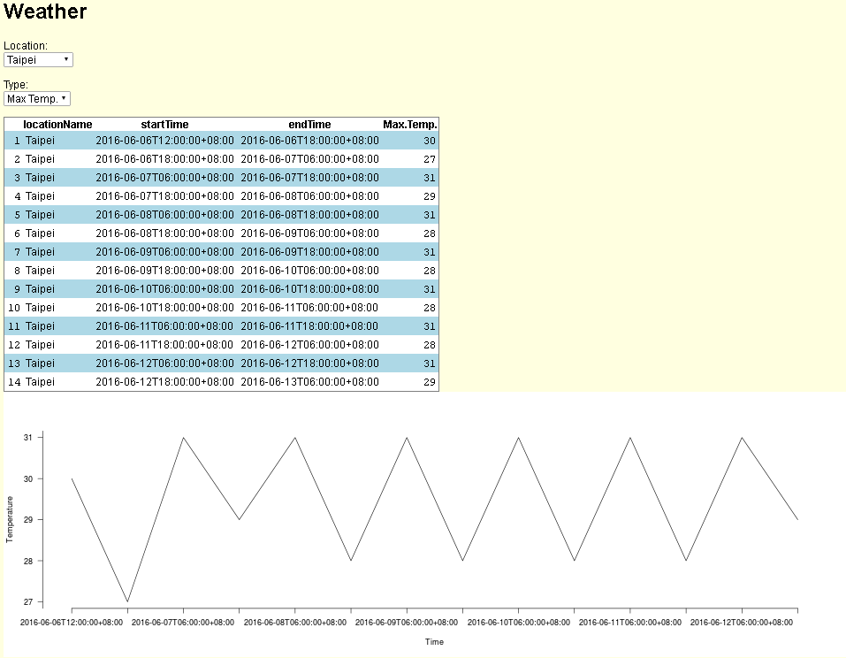
From HTML (include CSS)

Slide 39
From HTML + SQL
www/index.html
<!DOCTYPE html>
<html>
<head>
<title>Weather</title>
<script src="shared/jquery.js" type="text/javascript"></script>
<script src="shared/shiny.js" type="text/javascript"></script>
<link rel="stylesheet" type="text/css" href="shared/shiny.css">
</head>
<body>
<form action="#">
<p>
<label>From Date:</label>
<input type="text" name="from" value="2014-01-01">
<label>To Date:</label>
<input type="text" name="to" value="2014-12-31"><br />
<label>Type:</label>
<select name="type">
<option value="PM10"> PM10</option>
<option value="PM2.5"> PM2.5</option>
</select><br/>
</p>
<div id="mpgPlot" class="shiny-plot-output" style="width: 50%; height: 400px"></div>
</form>
</body>
</html>

Slide 40
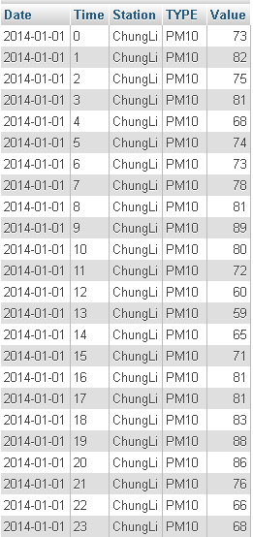
From HTML + SQL
http://140.138.77.70/phpmyadmin/
server.R
> library(shiny)
> library(dplyr)
> library(ggplot2)
> library(RMySQL)
> shinyServer(function(input, output) {
> datasetInput <- reactive({
> con =dbConnect(RMySQL::MySQL(),dbname="CS528A",host="localhost"
+ ,username="CS528A",password="CS528A")
> sql = paste("SELECT `Date`,`Station`,avg(`Value`) FROM `Air` WHERE
+ `Date` >='",input$from,"' and `Date` <='",input$to,"' and `TYPE` LIKE
+ '",input$type,"' group by `Date`, `Station`",sep="")
> res = dbSendQuery(con, sql)
> raw = fetch(res, n = -1)
> raw
> })
> output$mpgPlot <- renderPlot({
> dataset = datasetInput()
> colnames(dataset)=c("Date","Station","Ave")
> ggplot(dataset, aes(Date, Ave, group=Station, colour=Station)) + geom_line()
+ + labs(x="Date", y=input$type, title=paste("2014 ChungLi ",input$type))
+ + theme(legend.position = "none")
> })
> })

Slide 41
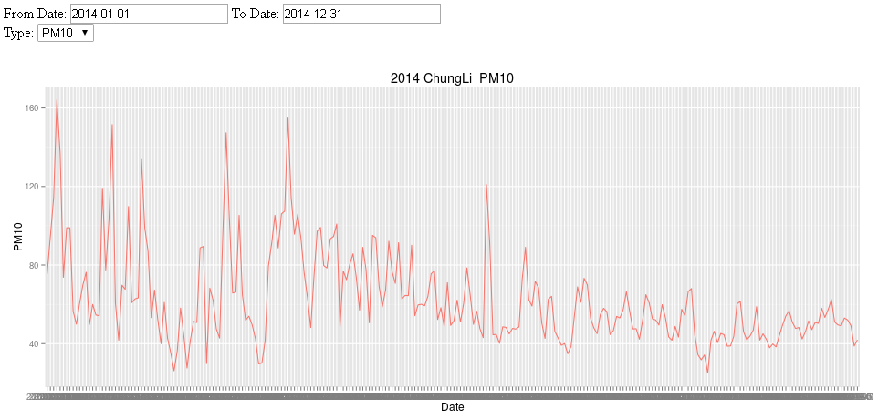
From HTML + SQL

Slide 42
DateInput
ui.R
> shinyUI(fluidPage(
> dateInput("from", label = h3("From Date"), value = "2014-01-01"),
> dateInput("to", label = h3("To Date"), value = "2014-12-31"),
> radioButtons("type", "TYPE",choices = c("PM10", "PM2.5")),
> hr(),
> fluidRow(column(12, plotOutput("mpgPlot")))
> ))

Slide 43
DateInput
server.R
> library(shiny)
> library(dplyr)
> library(ggplot2)
> library(RMySQL)
> shinyServer(function(input, output) {
> datasetInput <- reactive({
> con =dbConnect(RMySQL::MySQL(),dbname="CS528A",host="localhost"
+ ,username="CS528A",password="CS528A")
> sql = paste("SELECT `Date`,`Station`,avg(`Value`) FROM `Air` WHERE
+ `Date` >='",input$from,"' and `Date` <='",input$to,"' and `TYPE` LIKE
+ '",input$type,"' group by `Date`,`Station`",sep="")
> res = dbSendQuery(con, sql)
> raw = fetch(res, n = -1)
> raw
> })
> output$mpgPlot <- renderPlot({
> dataset = datasetInput()
> colnames(dataset)=c("Date","Station","Ave")
> ggplot(dataset, aes(Date, Ave, group=Station, colour=Station)) + geom_line()
+ + labs(x="Date", y=input$type, title=paste("2014 ChungLi ",input$type))
+ + theme(legend.position = "none")
> })
> })

Slide 44
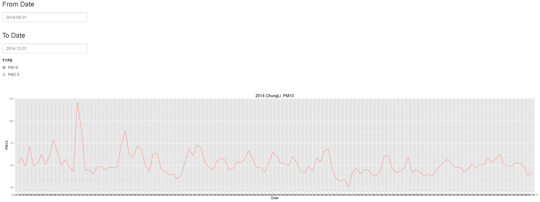
DateInput

Slide 45
Exercise
Dataset
From database: localhost (140.138.77.70 or 140.138.152.215)
Database name: Weather
UserName: CS528A
Password: CS528A
stno:
Taipei(466920), New Taipei(466880), Taichung(467490), Tainan(467420), Kaohsiung(467440)
Type:
Ave Temp.(TX01), Max Temp. (TX04), Min Temp.(TX06), Wind Speed(WD01), Ave Humidity (RH01), Ave Air Pressure(PS01)

Slide 46
Exercise
ui.R
> library(shiny)
> shinyUI(fluidPage(
> dateInput("from", label = h3("From Date"), format="yyyy-mm",value = "2000-01"),
> dateInput("to", label = h3("To Date"), format="yyyy-mm",value = "2015-12"),
> radioButtons("stno", "Station",
+ choices = c("Taipei", "New Taipei","Taichung","Tainan","Kaohsiung"),inline=TRUE),
> radioButtons("type", "TYPE",
+ choices = c("Ave Temp.", "Max Temp.","Min Temp.","Wind Speed","Ave Humidity","Ave Air Pressure"),inline=TRUE),
> hr(),
> submitButton("Update View"),
> fluidRow(column(12, plotOutput("mpgPlot")))
> ))

Slide 47
Exercise
> library(shiny)
> library(dplyr)
> library(ggplot2)
> library(RMySQL)
> shinyServer(function(input, output) {
> station <- reactive({
> switch(input$stno,
> "Taipei" = "466920",
> "New Taipei" = "466880",
> "Taichung" = "467490",
> "Tainan" = "467420",
> "Kaohsiung" = "467440")
> })
> type <- reactive({
> switch(input$type,
> "Ave Temp." = "TX01",
> "Max Temp." = "TX04",
> "Min Temp." = "TX06",
> "Wind Speed" = "WD01",
> "Ave Humidity" = "RH01",
> "Ave Air Pressure" ="PS01"
> )
> })
…
server.R

Slide 48
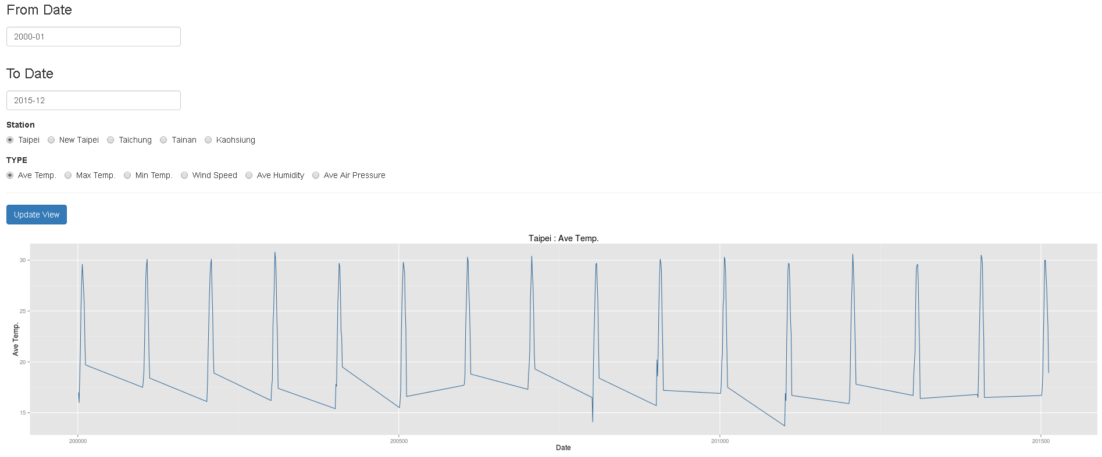
Exercise

Slide 49

HTML tag (image)
ui.R
> library(shiny)
> shinyUI(fluidPage(
> titlePanel("Image tag"),
> sidebarLayout(
> sidebarPanel(
> selectInput("dataset", "Choose a image:", choices = c("R", "Java"))
> ),
> mainPanel(
> htmlOutput("view")
> )
> )
>))

Slide 50
HTML tag (image)
server.R
> library(shiny)
> library(datasets)
> shinyServer(function(input, output) {
> datasetInput <- reactive({
> switch(input$dataset,
> "R" = "http://www.r-project.org/Rlogo.png",
> "Java" = "http://d3gnp09177mxuh.cloudfront.net/tech-page-images/java.png")
> })
> output$view <- renderUI({
> img=tags$img(src=datasetInput(),width=500,heigth=500)
> h6("Image:",br(),img)
> })
>})

Slide 51
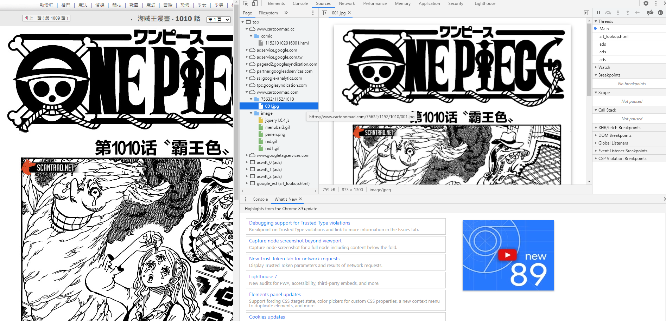
Exercise
Comic viewer
https://www.cartoonmad.com/
Image url

Slide 52
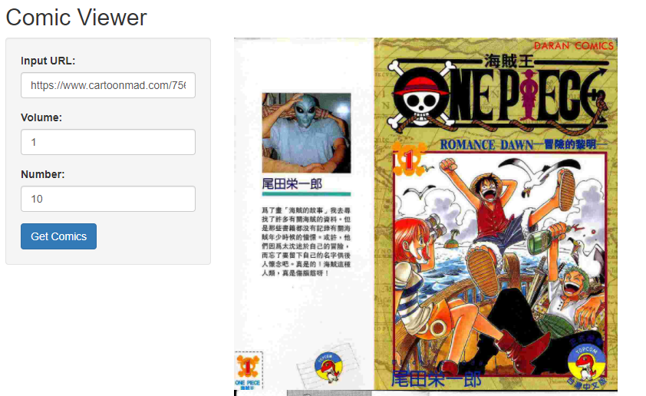
Exercise
URL Prefix
page

Slide 53
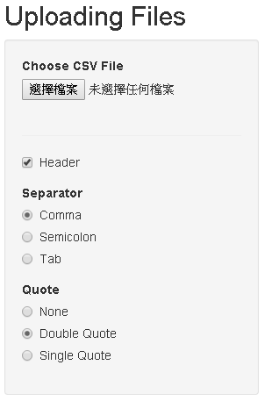
Upload file
ui.R
> library(shiny)
> shinyUI(fluidPage(
> titlePanel("Uploading Files"),
> sidebarLayout(
> sidebarPanel(
> fileInput('file1', 'Choose CSV File', accept=c('text/csv',
+ 'text/comma-separated-values,text/plain', '.csv')),
> tags$hr(),
> checkboxInput('header', 'Header', TRUE),
> radioButtons('sep', 'Separator', c(Comma=',', Semicolon=';', Tab='\t'), ','),
> radioButtons('quote', 'Quote',c(None='','Double Quote'='"','Single Quote'="'"),'"')
> ),
> mainPanel(
> tableOutput('contents')
> )
> )
>))
MIME type
Default value
MIME Type: https://en.wikipedia.org/wiki/Internet_media_type

Slide 54
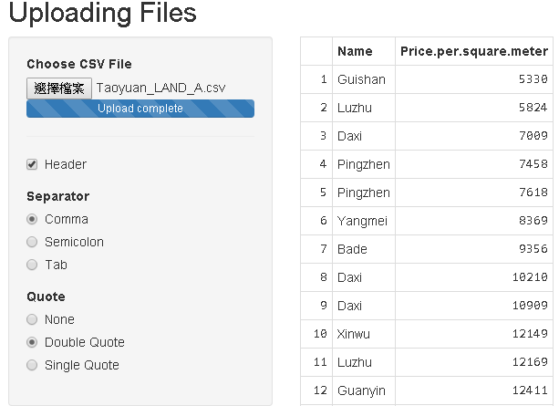
Upload file
server.R
> library(shiny)
> shinyServer(function(input, output) {
> output$contents <- renderTable({
> inFile = input$file1
> if (is.null(inFile))
> return(NULL)
> read.csv(inFile$datapath, header=input$header, sep=input$sep, quote=input$quote)
> })
>})

Slide 55
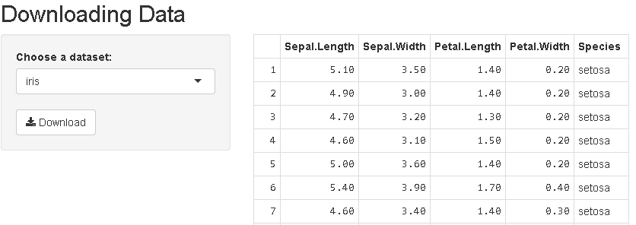
Download File
ui.R
> library(shiny)
> shinyUI(fluidPage(
> titlePanel("Downloading Data"),
> sidebarLayout(
> sidebarPanel(
> selectInput("dataset", "Choose a dataset:", choices = c("iris", "mtcars", "USArrests")),
> downloadButton('downloadData', 'Download')
> ),
> mainPanel(
> tableOutput("view")
> )
> )
>))

Slide 56
Download File
server.R
> shinyServer(function(input, output) {
> datasetInput <- reactive({
> switch(input$dataset,
> "iris" = iris,
> "mtcars" = mtcars,
> "USArrests" = USArrests)
> })
> output$view <- renderTable({
> datasetInput()
> })
> output$downloadData <- downloadHandler(
> filename = function() { paste(input$dataset, '.csv', sep='') },
> content = function(file) { write.csv(datasetInput(), file)}
> )
>})

Slide 57
Exercise
Dataset
From database: localhost
Database name: Weather
UserName: CS528A
Password: CS528A
stno:
Taipei(466920), New Taipei(466880), Taichung(467490), Tainan(467420), Kaohsiung(467440)
Type:
Ave Temp.(TX01), Max Temp. (TX04), Min Temp.(TX06), Wind Speed(WD01), Ave Humidity (RH01), Ave Air Pressure(PS01)
Note: Download Dataset

Slide 58
Exercise
ui.R
> library(shiny)
> shinyUI(fluidPage(
> dateInput("from", label = h3("From Date"), format="yyyy-mm",value = "2000-01"),
> dateInput("to", label = h3("To Date"), format="yyyy-mm",value = "2015-12"),
> radioButtons("stno", "Station",
+ choices = c("Taipei", "New Taipei","Taichung","Tainan","Kaohsiung"),inline=TRUE),
> radioButtons("type", "TYPE",
+ choices = c("Ave Temp.", "Max Temp.","Min Temp.","Wind Speed","Ave Humidity","Ave Air Pressure"),inline=TRUE),
> br(),
> submitButton("Update View"),
> br(),
> downloadButton('downloadData', 'Download'),
> fluidRow(column(12, plotOutput("mpgPlot")))
> ))

Slide 59
Exercise
> library(shiny)
> library(dplyr)
> library(ggplot2)
> library(RMySQL)
> shinyServer(function(input, output) {
> station <- reactive({
> switch(input$stno,
> "Taipei" = "466920",
> "New Taipei" = "466880",
> "Taichung" = "467490",
> "Tainan" = "467420",
> "Kaohsiung" = "467440")
> })
> type <- reactive({
> switch(input$type,
> "Ave Temp." = "TX01",
> "Max Temp." = "TX04",
> "Min Temp." = "TX06",
> "Wind Speed" = "WD01",
> "Ave Humidity" = "RH01",
> "Ave Air Pressure" ="PS01"
> )
> })
…
server.R

Slide 60
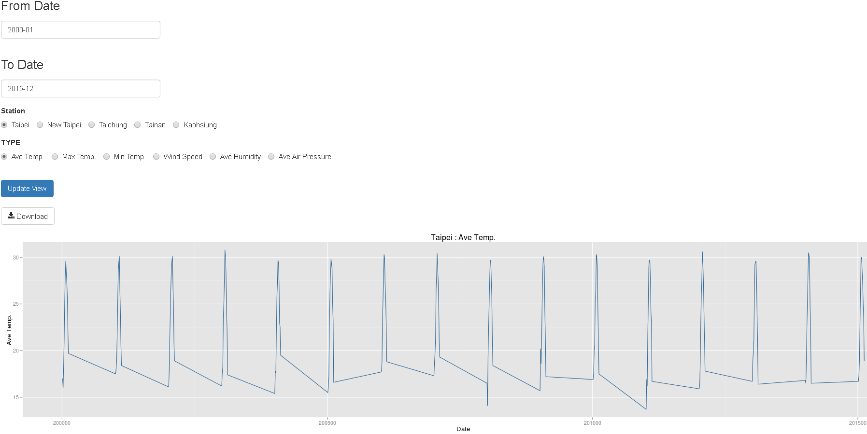
Exercise

Slide 61
Dynamic UI + Plotly
ui.r
> library(shiny)
> library(plotly)
> shinyUI(fluidPage(
> titlePanel("Bar Plot"),
> sidebarLayout(
> sidebarPanel(
> fileInput('file1','Upload File',accept=c('text/csv',
+ 'text/comma-separated-values,text/plain','.csv',
+ '.txt','text/txt','text/plain')),
> uiOutput("ui")
> ),
> mainPanel(
> plotlyOutput("plot")
> )
> )
> ))

Slide 62
Dynamic UI + Plotly
server.r
> library(shiny)
> library(plotly)
> shinyServer(function(input,output){
> output$ui<-renderUI({
> inFile=input$file1
> if(is.null(inFile))
> return(NULL)
> data=read.table(inFile$datapath,header=T,sep=",")
> cname=colnames(data)
> list(
> selectInput("col","Select Column:",cname[-1])
> )
> })
> output$plot<-renderPlotly({
> inFile=input$file1
> if(is.null(inFile)) return(NULL)
> if(input$col=="") return(NULL)
> data=read.table(inFile$datapath,header=T,sep=",")
> ix = which(colnames(data)==input$col)
> p = plot_ly( x = data[,1], y = data[,ix], name = input$col, type = "bar")
> p
> })
> })

Slide 63
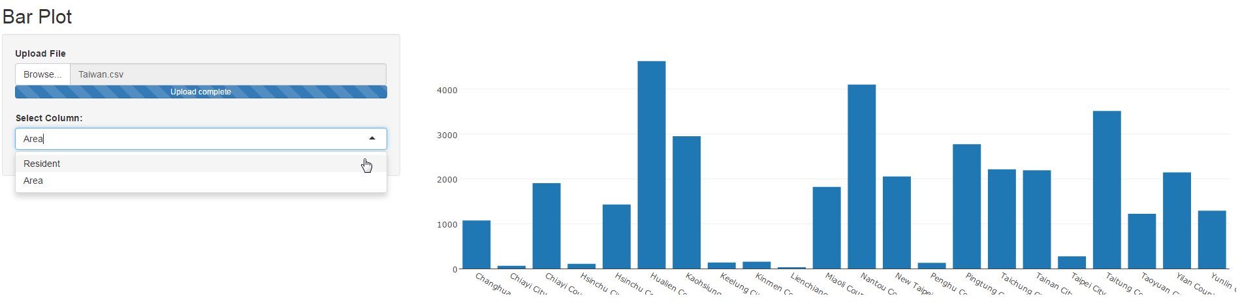
Dynamic UI + Plotly
Example: Taiwan.csv

Slide 64
Multiple selectInput
ui.r
> library(shiny)
> library(plotly)
> shinyUI(fluidPage(
> titlePanel("Bar Plot"),
> sidebarLayout(
> sidebarPanel(
> fileInput('file1','Upload File',accept=c('text/csv',
+ 'text/comma-separated-values,text/plain','.csv',
+ '.txt','text/txt','text/plain')),
> uiOutput("ui")
> ),
> mainPanel(
> plotlyOutput("plot")
> )
> )
> ))

Slide 65
Multiple selectInput
> library(shiny)
> library(plotly)
> shinyServer(function(input,output){
> output$ui<-renderUI({
> inFile=input$file1
> if(is.null(inFile))
> return(NULL)
> data=read.table(inFile$datapath,header=T,sep=",")
> cname=colnames(data)
> list(
> selectInput("col","Select Column:",choices = cname[-1],
+ selected=cname[-1],multiple=T)
> )
> })
> output$plot<-renderPlotly({
> inFile=input$file1
> if(is.null(inFile)) return(NULL)
> if(length(input$col)<1) return(NULL)
> data=read.table(inFile$datapath,header=T,sep=",")
> ix = NULL
> for (i in 1:length(input$col))
> {
> ix[i] = which(colnames(data)==input$col[i])
> }
> p = plot_ly( x = data[,1], y = data[,ix[1]], name = input$col[1], type = "bar")
> if (length(input$col) == 2)
> {
> p = p %>% add_trace( y = data[,ix[2]], name = input$col[2]) %>%
+ layout(yaxis = list(title = 'Count'), barmode = 'group')
> }
> p
> })
> })

Slide 66
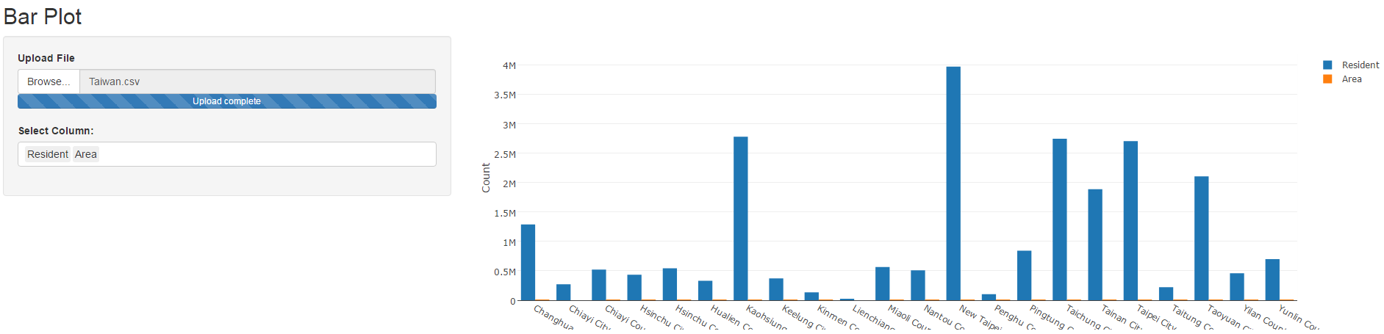
Multiple selectInput
Example: Taiwan.csv

Slide 67
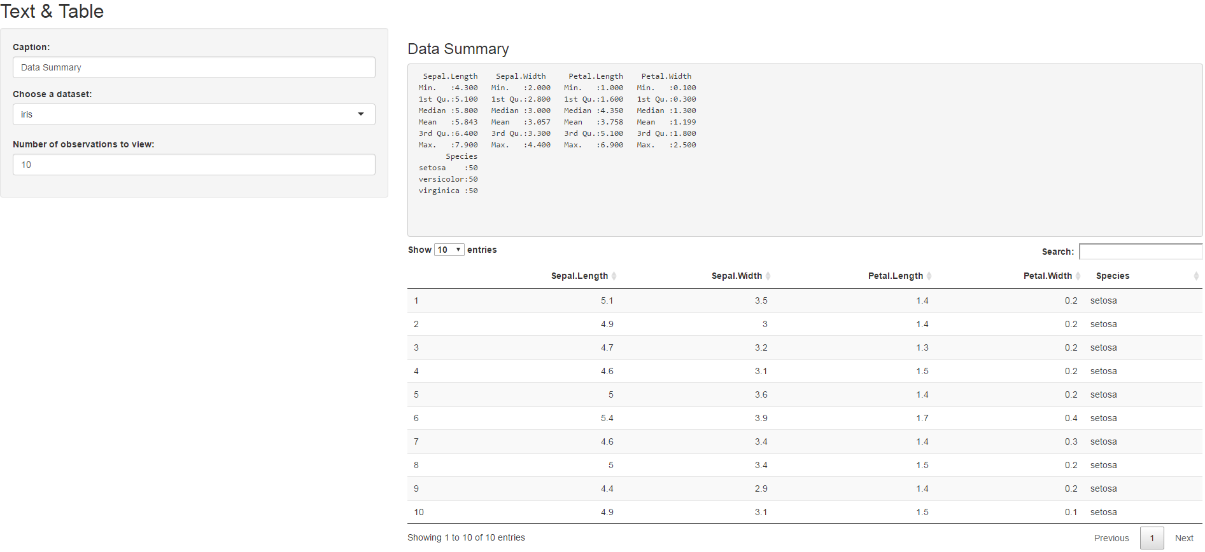
DT::datatable
ui.r
> library(shiny)
> shinyUI(fluidPage(
> titlePanel("Text & Table"),
> sidebarLayout(
> sidebarPanel(
> textInput("caption", "Caption:", "Data Summary"),
> selectInput("dataset", "Choose a dataset:",
+ choices = c("iris", "mtcars", "USArrests")),
> numericInput("obs", "Number of observations to view:", 10)
> ),
> mainPanel(
> h3(textOutput("caption", container = span)),
> verbatimTextOutput("summary"),
> DT::dataTableOutput("view")
> )
> )
>))

Slide 68
DT::datatable
server.r
> library(shiny)
> library(datasets)
> shinyServer(function(input, output) {
> datasetInput <- reactive({
> switch(input$dataset,
> "iris" = iris,
> "mtcars" = mtcars,
> "USArrests" = USArrests)
> })
> output$caption <- renderText({
> input$caption
> })
> output$summary <- renderPrint({
> dataset = datasetInput()
> summary(dataset)
> })
> output$view <- DT::renderDataTable({
> head(datasetInput(), n = input$obs)
> })
>})

Slide 69
Exercise
Please create a dynamic ui based on user input file
selectInput
Taipei_LAND_A.csv
Please show the boxplot (plotly package) based on user multiple selection.

Slide 70
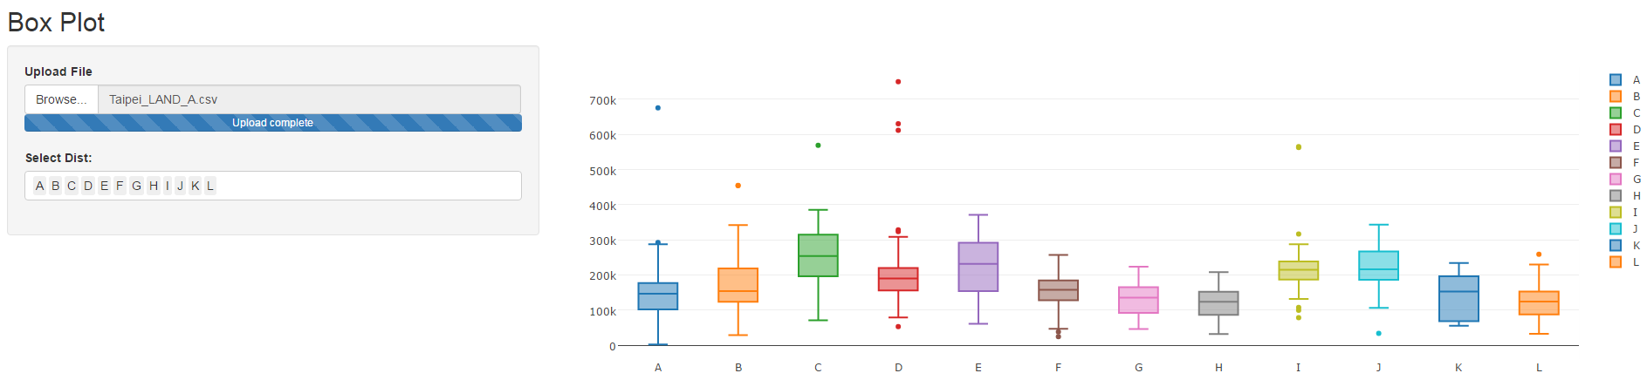
Exercise

Slide 71
Web Resource
https://github.com/rstudio/shiny-examples

Slide 72
Q&A

